Slide 1
Remote Sensing
Solving the Range Problem
Feb 25, 2025 David Powell

Slide 2
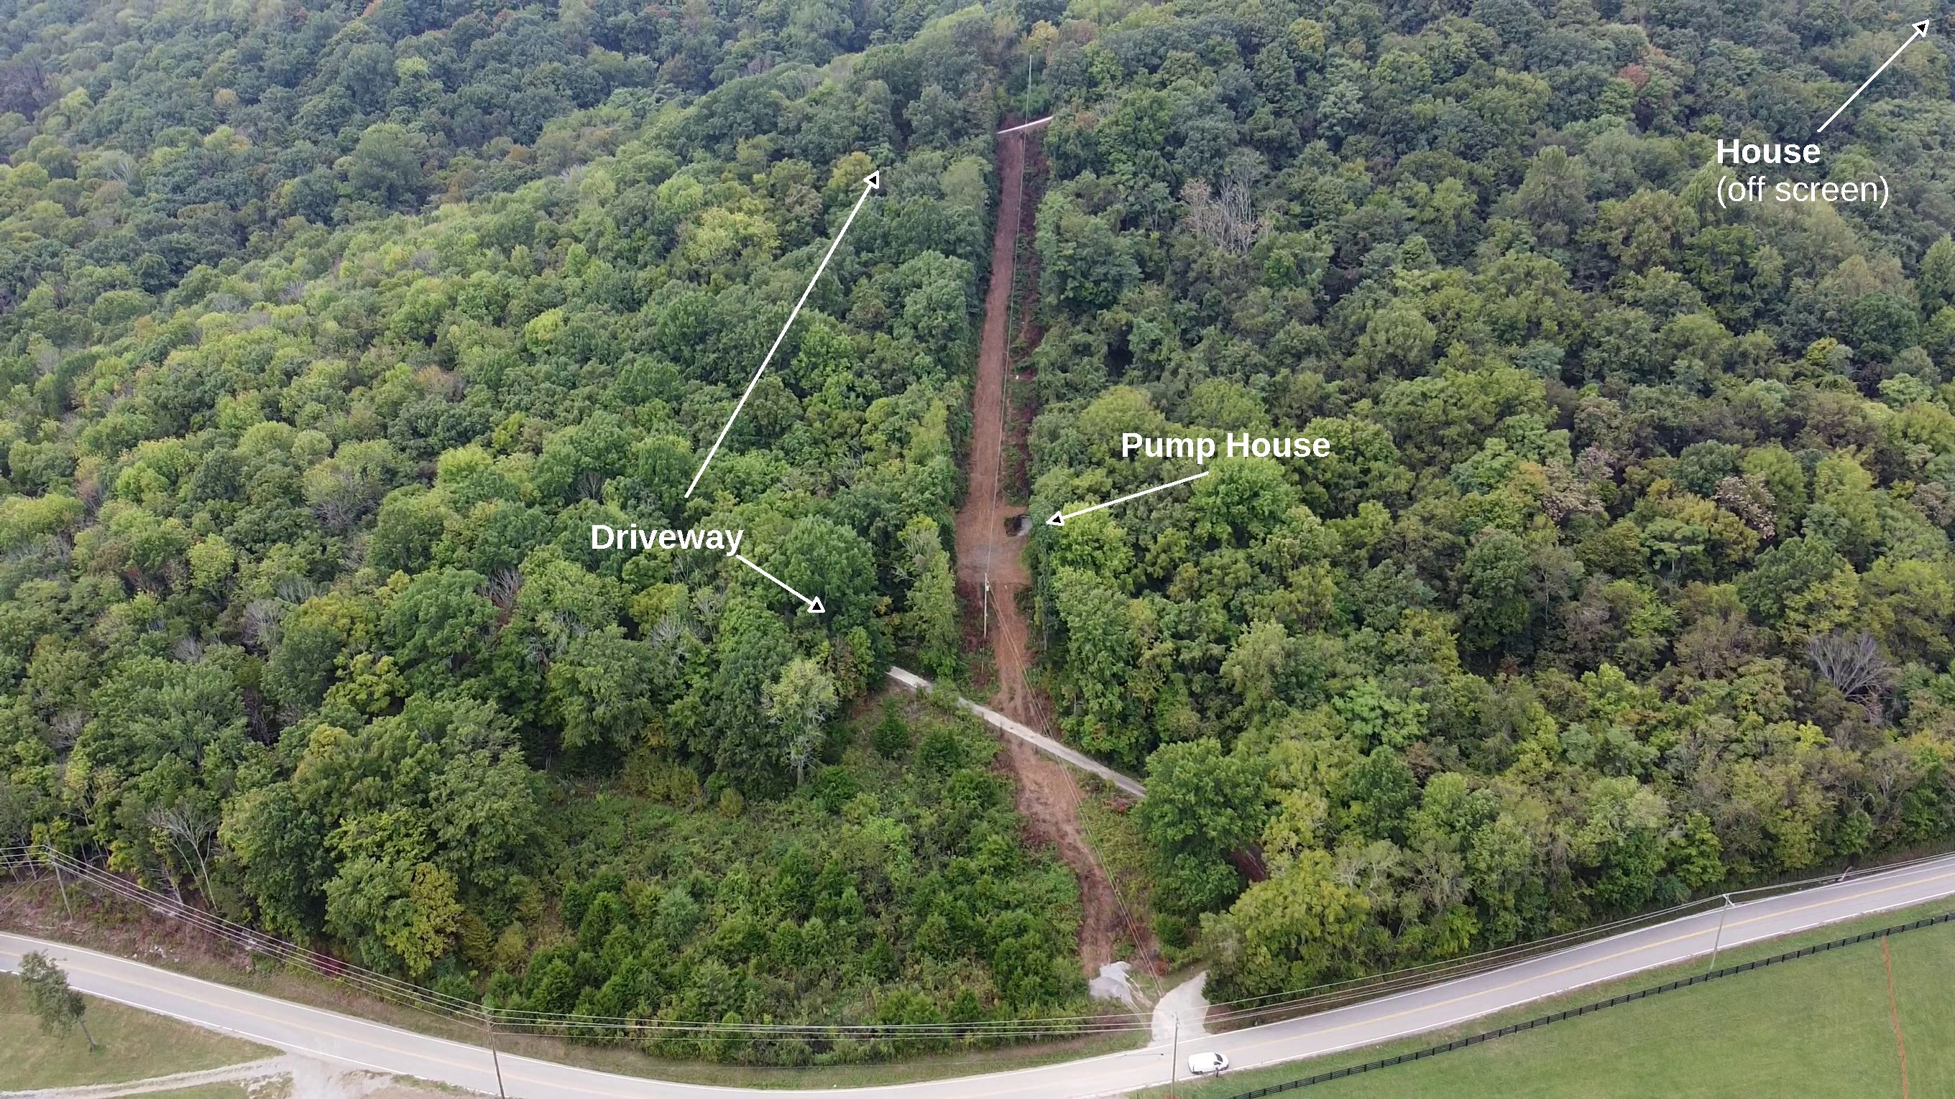
The Problem:
The street is at the bottom of the photo. My driveway comes off the street and winds back and forth up the side of the hill to the house (out of the picture at the top right). The brown line going up the hill is my new water line.

Slide 3
The Problem: (pg. 4)
Delivery drivers don’t like coming up my driveway
I need a way to get packages delivered
I need to know when a package was delivered, and if it was removed
It’s too far to run a wire or use WiFi. No cellular service either!

Slide 4
What I need is:
A delivery box where delivery drivers can put my packages
A way to detect when a package is delivered or removed
A way to communicate that information to Home Assistant
A power source that doesn’t need any attention to keep working

Slide 5
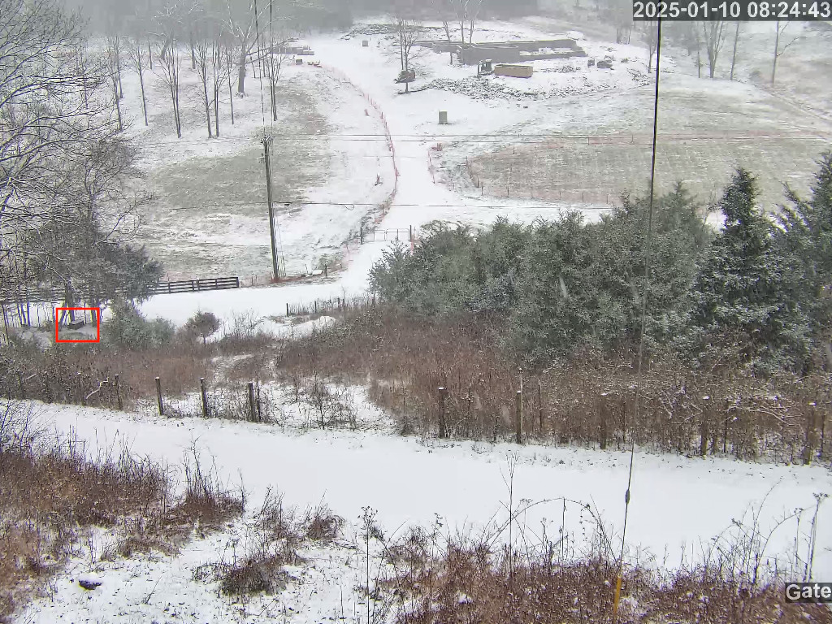
The Delivery Box
The location of the delivery box, as seen from below the pump house.

Slide 6
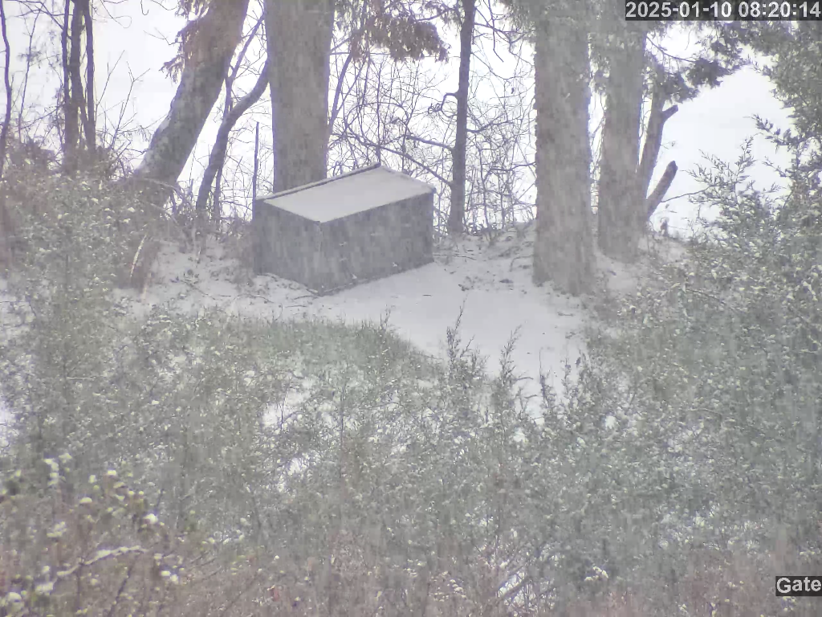
The Delivery Box
The delivery box hides behind some trees at the bottom of the driveway.

Slide 7
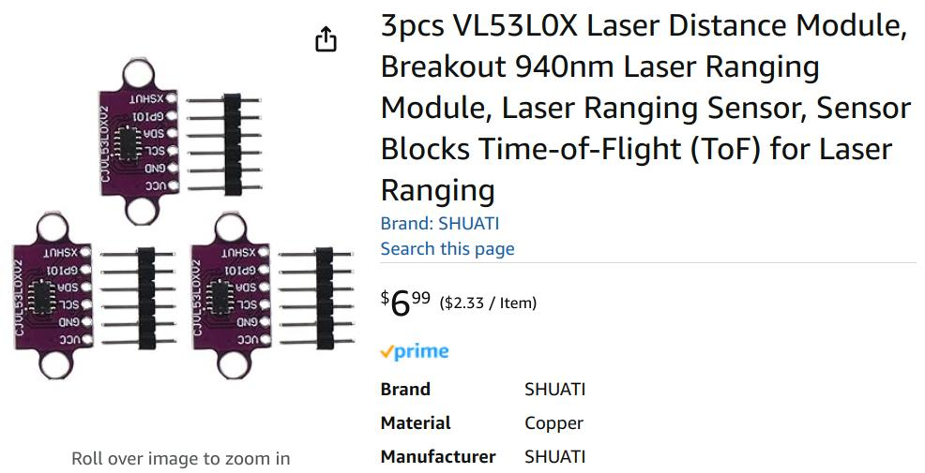
Available on Amazon

Slide 8
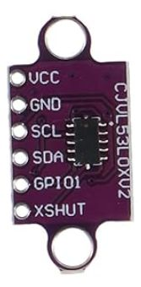
Laser Ranging Module
VCC – 2.6v to 5.5v
GND – Ground
SCL – IIC Clock
SDA – IIC Data
GPIO1 – A general purpose mystery output
XSHUT – Drive this low to hold the device reset (low power)

Slide 9
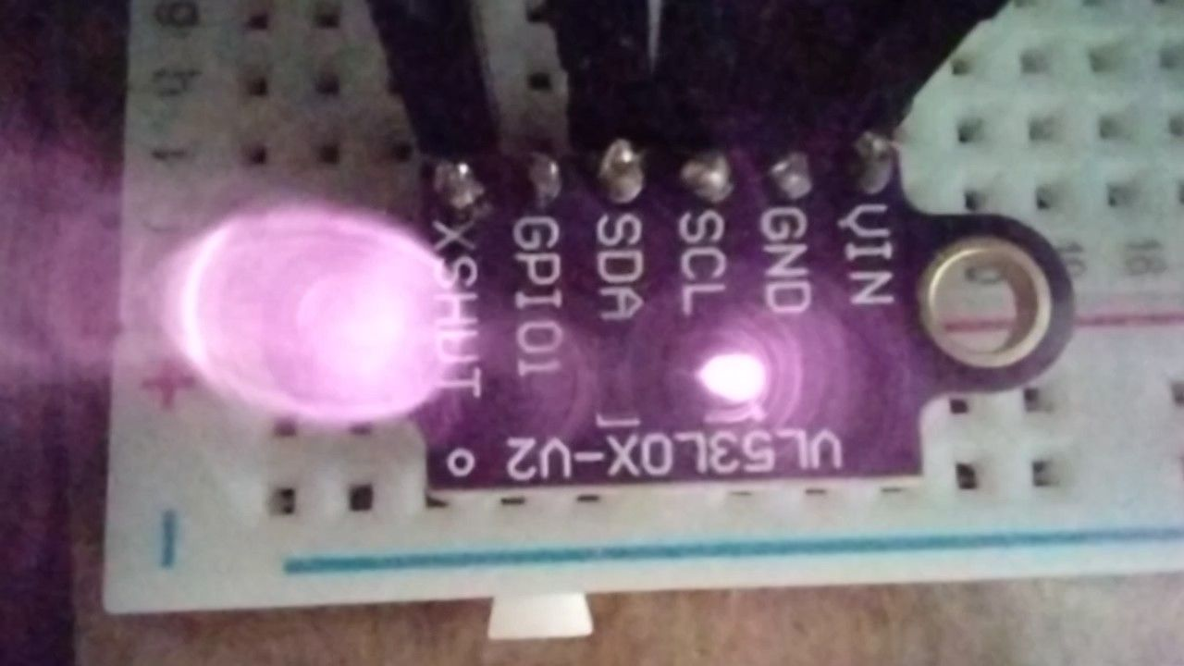
Laser is Infrared (940 nm)

Slide 10
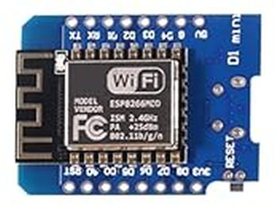
ESP D1 Mini

Slide 11
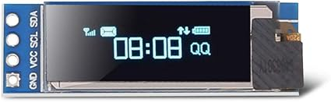
0.91” OLED Display

Slide 12
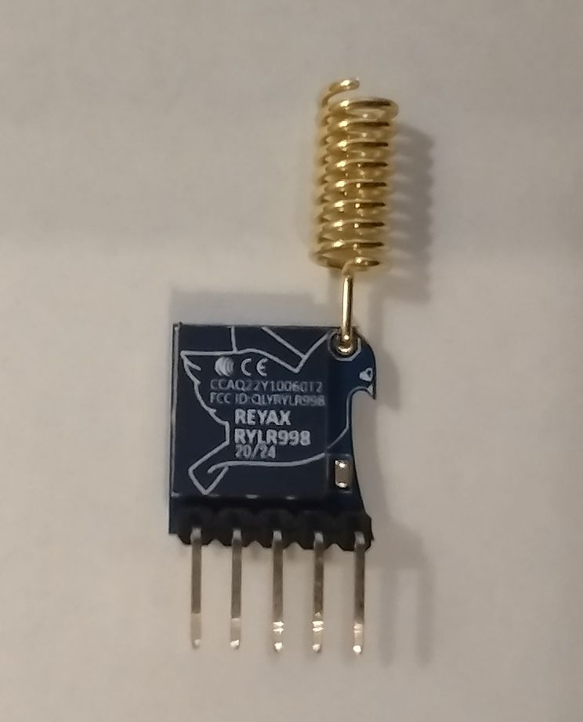
RYLR998 LoRa Transciever
FCC certified
Built-in antenna
Reports of reliable 1.5 km range
Simple AT command structure
Adjustable power, frequency, baud rate, spreading factor, bandwidth, address, network ID
Communications can be password protected
No message delivery confirmation!

Slide 13
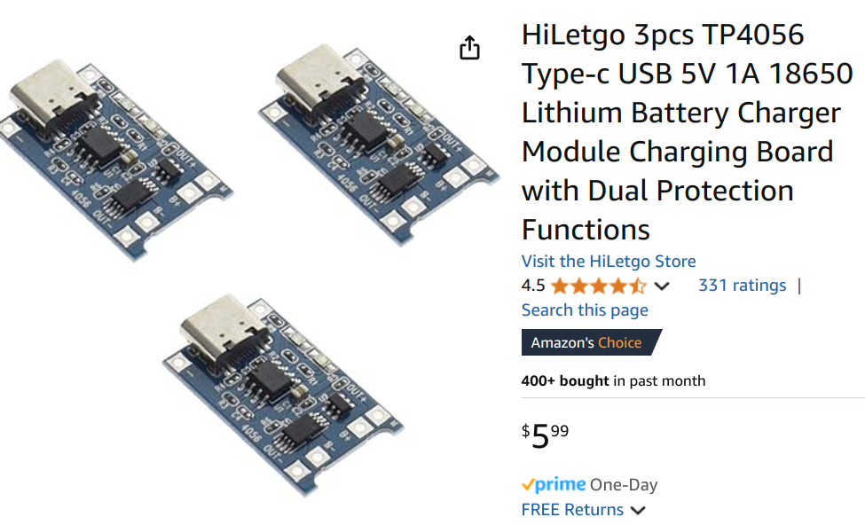
Battery Manager
Prevents battery over-charge and over-discharge
Can be connected to USB power if needed
4.35-6 volt input
4.2 volt output
Up to 3A discharge capacity
Up to 1A charge capacity

Slide 14
Block Diagram
Pump House
Fiber Cable
Raspberry
Pi
Home
Assistant
Receiver
House
Delivery Box
Transmitter
Package

Slide 15
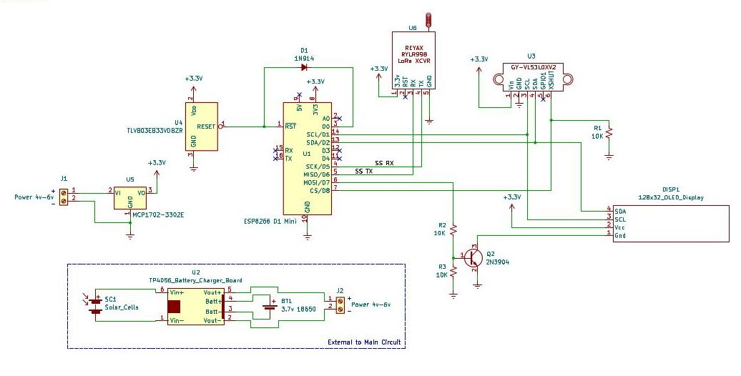
Schematic - Sensor/Transmitter

Slide 16
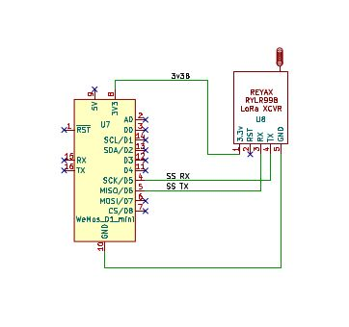
Schematic - Receiver

Slide 17
Software - Sensor/Transmitter
Sleeps most of the time; wakes every 5 minutes to check for a package
All parameters are configurable via the USB serial port
Display can be disabled to save more power
Each measurement is an average of 5 readings
Only reports a change after two consecutive measurements
A range of measurements can be set for package presence. If measurement is within the range then a package is present.

Slide 18
Software - Receiver
Does not sleep since it is USB powered.
Listens for incoming JSON-encoded LoRa messages.
Parses the message and sends an MQTT topic for each element.
Configuration can be done via USB or MQTT commands.
MQTT communication is done via WiFi.

Slide 19
Hardware Sources
3 pcs VL53L0X Laser Distance Module ($6.99)
https://www.amazon.com/dp/B0CQ28Q3KC
RYLR998 868/915 MHz Lora Module ($12.60)
https://www.amazon.com/dp/B099RM1XMG
5 pcs ESP8266 Mini D1 Module ($13.99)
https://www.amazon.com/gp/product/B081PX9YFV
2 PCS 0.91'' IIC OLED Display Module ($5.99)
https://www.amazon.com/gp/product/B07FMDB6TR/
3pcs TP4056 18650 Lithium Battery Charger Module
https://www.amazon.com/dp/B07PKND8KG

Slide 20
Resources
Reyax RYLR998 AT Command User Guide:
https://manuals.plus/reyax-technology/rylr998-lora-at-command-guide-manual
VL53L0X Time-Of-Flight Ranging Sensor
https://www.st.com/resource/en/datasheet/vl53l0x.pdf
SSD1306 OLED Display Driver Data Sheet
https://cdn-shop.adafruit.com/datasheets/SSD1306.pdf
TP4056 Lithium Ion Battery Management Board
https://dlnmh9ip6v2uc.cloudfront.net/datasheets/Prototyping/TP4056.pdf

